Slide 1
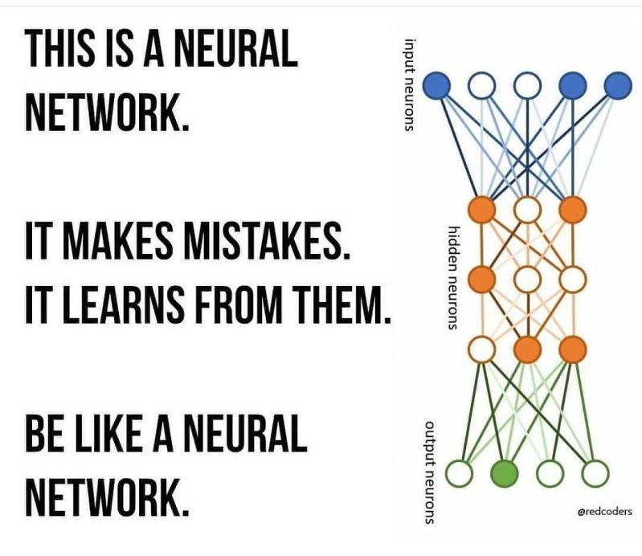

Slide 2
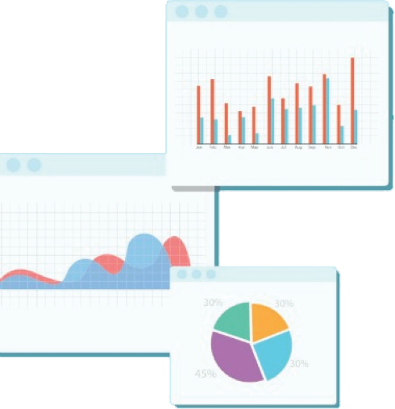


Welcome to Week 11
Lecture 1!
Data Science in Python &
Machine Learning

Slide 3
Feature Engineering Review
What is one way you can engineer your features?
Extract month, week, day, hour, etc. from datetime
binning
Combine columns
Pca/ dimensionality reduction. Feature extraction
LCA
Log transforms, other transformation, sqrt, cbrt, square
Feature selection
Scaling
Encoding

Slide 4
Last Lecture Learning Goals
You are now able to:
Identify features for engineering
Select appropriate engineering strategies
Create non-linear feature combinations with PolynomialFeatures
Apply feature engineering to a dataset to improve model performance

Slide 5
Learning Goals
After this lesson you will be able to:
Summarize Forward Propagation
Explain how gradient descent relates to model learning
Visualize how a neural network learns to solve a problem.
Code a simple feed-forward neural network in Keras using densely connected layers.

Slide 6
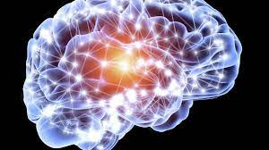
Neural Networks are Like Brains
Neurons (nodes)
and connections (weights)
Learn by Trial and Error
Image Source

Slide 7
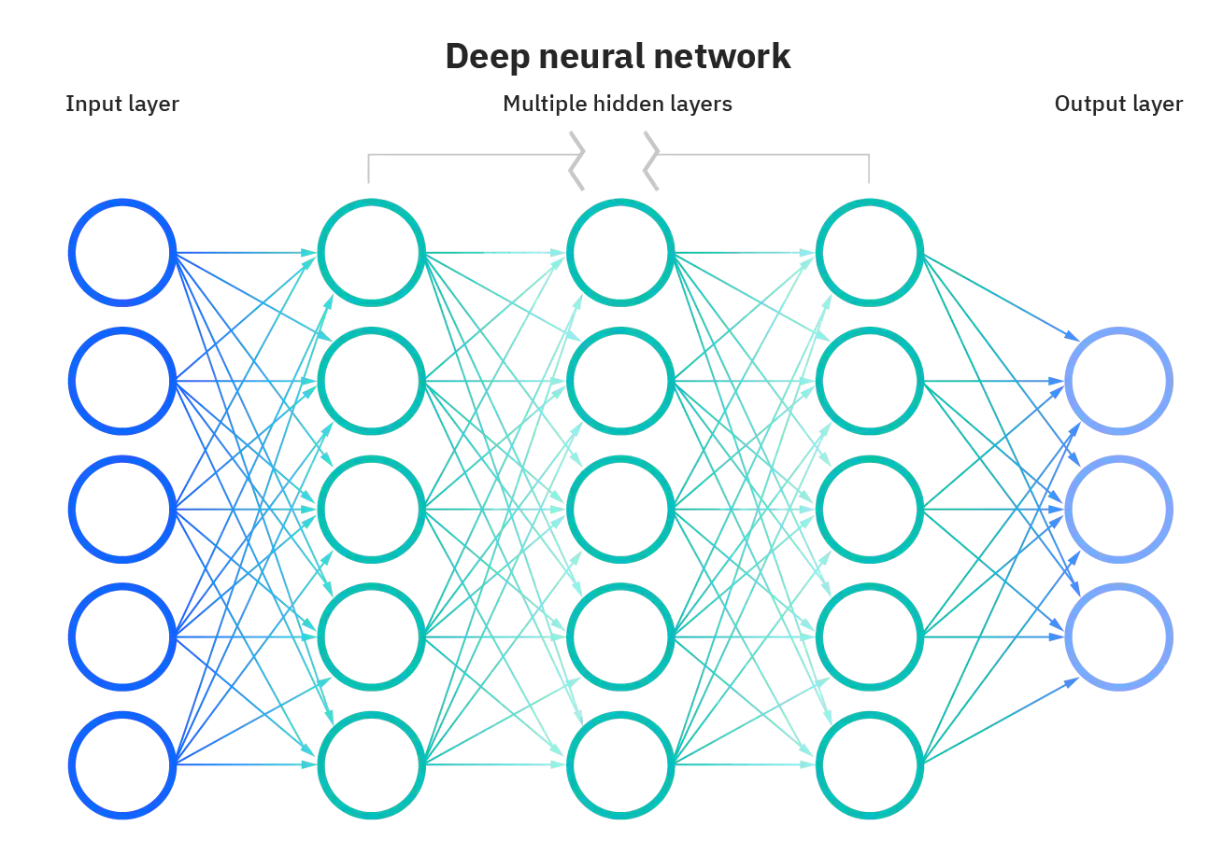
Neural Networks:
Multi-Layered Perceptrons
Image Source

Slide 8

Neural Networks Overview
Possibly Many Layers
Every layer discovers increasingly complex patterns
Solve MANY different kinds of problems.
Image Source

Slide 9
Iterative Learning
Forward Propagation
Make predictions.
“What if I try…?”
Calculate Cost (total error).
“How far off was I?”
Backward Propagation
Change weights with Gradient Descent.
“How can I do better?
Repeat!

Slide 10
Forward Propagation
Features go in…
…Prediction
comes out
Data moves forward through the layers and is processed at each step.
The final output is the model prediction
Image Source

Slide 11
Forward Propagation
Does this formula look familiar?
y_pred = Σ(x_{i}*w_{i}) + bias
translation:
prediction = sum of weights times features, plus intercept (bias term)
Image Source

Slide 12
Input
Think back to linear regression:
Each feature is multiplied by a coefficient (weight) and they are added together along with the intercept.
Each feature has an independent contribution
Model improves by changing the weights
X1
Feature 1
W1
Model
X2
Feature 2
W2
X1 * W1
+ X2 * W2
+ X3 * W3
+ X4 * W4
+ X5 * W5
+ Intercept
Feature 3
W3
Prediction
X3
=
W4
X4
Feature 4
W5
linear model Y = Σ(x_{i}*w_{i}) + bias
X5
Feature 5

Slide 13
A neural network has (at least one) additional layer(s) that take into account interactions between features. This layer is made up of MULTIPLE linear regression models with different weights.
Input Layer
Hidden Layer
Feature 1
Node 1
Output Layer
Feature 2
Node 2
Prediction
Feature 3
Node 3
Feature 4
Node 4
Feature 5

Slide 14
This shows how Node 1 takes information from each feature to produce an output
Input Layer
Hidden Layer
Feature 1
Node 1
Output Layer
Feature 2
Node 2
Prediction
Feature 3
Node 3
Feature 4
Node 4
Feature 5

Slide 15
This happens with each of the nodes in the hidden layer
The more nodes we have, the more interactions we capture
Input Layer
Hidden Layer
Feature 1
Node 1
Output Layer
Feature 2
Node 2
Prediction
Feature 3
Node 3
Feature 4
Node 4
Feature 5

Slide 16
- For each node, a weight is applied to each feature.
Weights can be positive or negative
12
Weight: ?
3
Weight: ?
Node 1
Prediction
6
Weight: ?
Weight: ?
8
Weight: ?
2

Slide 17
- For each node, a weight is applied to each feature.
Weights can be positive or negative
- Weights are randomly initialized then adjusted as learning proceeds
12
Weight: 2
3
Weight: 4
Node 1
Prediction
6
Weight: -1
Weight: -3
8
Weight: 5
2

Slide 18
For example, let’s apply the weights shown
The greater the weight, the greater the influence of that feature on Node 1
12
12 x 2 = 24
3 x 4 = 12
6 x -1 = -6
8 X -3 = -24
2 X 5= 10
Bias = 0
Weight: 2
3
Weight: 4
= 16
Node 1
Prediction
6
Weight: -1
Weight: -3
8
Weight: 5
2

Slide 19
A similar process happens for EACH node
Each node has different weights. Note that this shows Node 2
12
12 x 3 =36
3 x -1 = -3
6 x 5 = 30
8 X -4 = -32
2 X 2 = 4
Weight: 3
3
Weight: -1
= 35
Weight: 5
Node 2
Prediction
6
Weight: -4
8
Weight: 2
2

Slide 20
Let’s demonstrate the effect of node weights
Input Layer
Hidden Layer
12
16
Output Layer
weight: 3
3
35
weight: -1
Prediction
6
weight: 1
-12
weight: 2
8
-8
2

Slide 21
The process repeats for each node
Input Layer
Hidden Layer
12
Node 1
Output Layer
16 * 3
3
Node 2
35 * -1
Prediction
6
-12 * 1
Node 3
-8 * 2
8
Node 4
2

Slide 22
The process repeats for each node
Input Layer
16 x 3 = 48
35 X -1 = -35
12 X 1 = 12
8 X 2 = 16
Hidden Layer
= 41
12
Node 1
Output Layer
16 * 3
3
Node 2
35 * -1
Prediction = 41
6
-12 * 1
Node 3
-8 * 2
8
Node 4
2

Slide 23
This is the model prediction for these features
Input Layer
16 x 3 = 48
35 X -1 = -35
12 X 1 = 12
8 X 2 = 16
Hidden Layer
= 41
12
16
Output Layer
weight: 3
3
35
weight: -1
Prediction = 41
6
weight: 1
-12
weight: 2
8
-8
2

Slide 24
Activation Function
Activation functions are applied to the output of each node before it is passed to the next layer.
These allow a neural network to find non-linear relationships between features and targets
The activation function can also limit the range of final outputs to match the problem type.
More info in Activation function

Slide 25
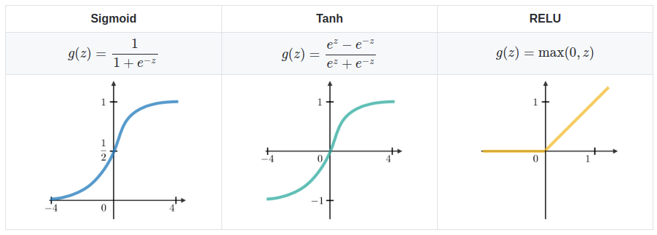
Activation Function
Hyperbolic tangent (Tanh) sometimes used instead of ReLU for hidden layers
Sigmoid is used for output layers for classification models
ReLU (Rectified Linear Activation) is very common for hidden layers
If the sum is positive, output is the input number
But, if the sum is negative, a value of 0 is applied instead

Slide 26
This is the model prediction for these features
Input Layer
Relu(16) * 3 = 48
Relu(35) * -1 = -35
Relu(-12) * 1 = 0
Relu(-8) * 2 = 0
Bias = 5
Hidden Layer
= 18
12
ReLU(16)
Output Layer
weight: 3
3
ReLU(35)
weight: -1
Prediction:
sigmoid(18) = .999
6
weight: 1
ReLU(-12)
weight: 2
8
ReLU(-8)
f() = activation function
2

Slide 27
Cost (AKA Loss)
Overall error on all training samples:
It’s a single number generated by a Cost function
Ex. Mean Squared Error, Mean Absolute Error
Lower must be better (no accuracy or R²)
Prediction | True Value | Error | Squared Error
5 | 4 | 1 | 1
7 | 8 | -1 | 1
-5 | -8 | 3 | 9
-8 | -5 | -3 | 9
MSE = 4.47

Slide 28
Summarize Forward Propagation
In your breakout groups:
Quickly choose :
a reporter who will take notes and share your summary to the whole class.
a facilitator to keep the conversation moving.
The rest are researchers who will study the slides and/or LP to help.
Work together to come up with a summary of the forward propagation process. In your group’s own words:
How does forward propagation work and what does it do?
Add your summary to the Padlet under your room number:
You have 5 minutes!

Slide 29
Backward Propagation
Backward propagation is the process changing the weights of the nodes to reduce the Cost (total error) of the model on the data
Changing the weights is the process of learning.
Input
Output

Slide 30
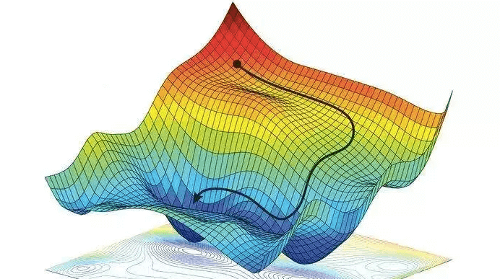
Backward Propagation:
Gradient Descent
Imagine:
A ball rolling down hill.
The Weights of the neural network is the ball.
The Cost is the altitude
Gradient Descent is gravity
Image Source

Slide 31
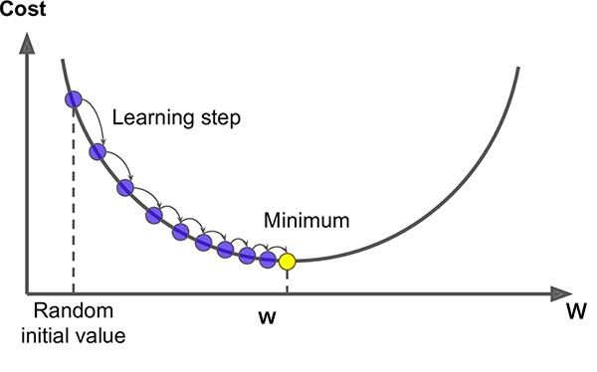
How does the model know how to adjust the weights?
Gradient Descent
Value of one specific weight

Slide 32
Back Propagation Poll
Backpropagation is the process of…

Slide 33
Epochs:
An Epoch is when:
Forward Propagation
Make predictions.
Calculate Cost.
Backward Propagation
Use Gradient Descent to change Weights.
Learn to do better next time!
Repeat!

Slide 34
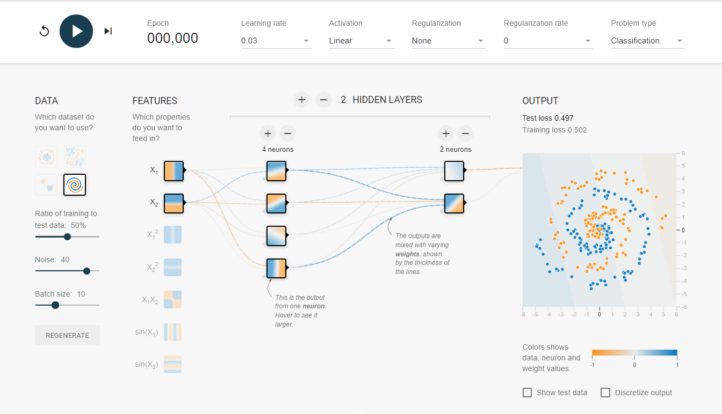
Visualizing the Neural Network in Action
In your breakout group (7 minutes):
Follow this link to Tensorflow Playground
Make sure your initial settings to match this image:
Adjust the following to minimize your testing loss:
Features
Layers
Neurons
Learning rate
Activation Function
Regularization
Be ready to share your best network and your best (lowest) testing loss.
Minimize This
Do Not Change These

Slide 35
Code-along
Next, we will go together to build a neural network in Keras.
Here is the notebook

Slide 36
Review:
Neural Networks are made up of layers of nodes and the weights between them.
Using forward propagation, they make guesses about how to solve a problem and determine how far off they were.
Using backward propagation, they change their weights to do better next time.
This process is called an epoch and it repeats many times.

Slide 37
Announcements
New Code Review Slots Open Tomorrow!!!
Sign up now!

Slide 38
Announcements
Assignments Due this Week by Friday at 9am PST
Belt Exam
This weekend!
February 10th-12th
Set aside 8-12 hours to complete
Must have attended 80% of classes
Must have submitted:
All assignments from weeks 1 & 2
and all resubmits from week 1.

Slide 39
Assignments Due:
Neural Network Exercise - Optional Kaggle Competition
Explain your Model Changes
Recommend you submit an entry!
Upload a screenshot of your score and rank on Discord!
Project 2 - Part 5 - Presentation slides
Remember: NON-DATA SCIENCE AUDIENCE!!!
Daily Schedule

Slide 40
Next Lecture: Tuning Neural Networks
Read:
Bias and Variance in Deep Learning
Dropout
Early Stopping
Regression Models in Keras
Binary Classification Models in Keras
Multiclass Classification Models in Keras
Daily Schedule

